Slide 1
CSS342 Data Structures, Algorithms, and Discrete Mathematics (I)

Slide 2

Recursion

Slide 3
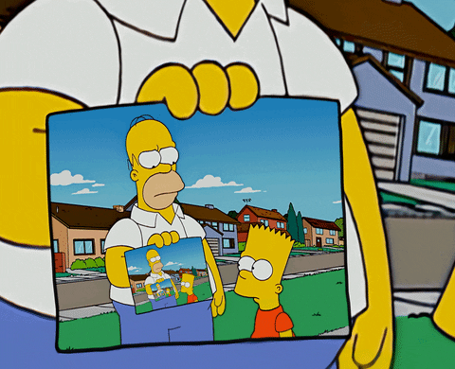
Recursion
A function calling itself
void callMe() {
callMe();
}
Not specific to Java

Slide 4
Why Recursion?
Problems of recurring nature
Problem using as complex data structure

Slide 5

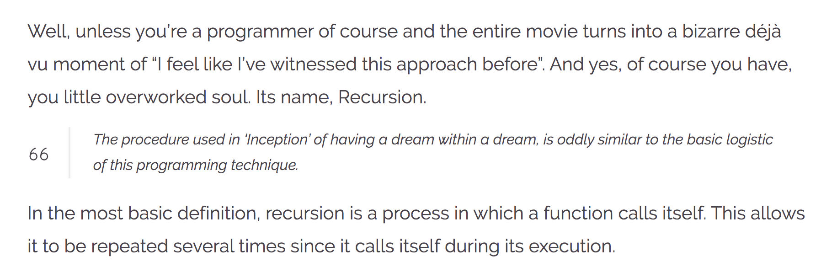
Recursion
https://wewrite.taleas.io/2018/11/14/why-inception-reminds-us-of-recursion/

Slide 6
Recursion

Slide 7
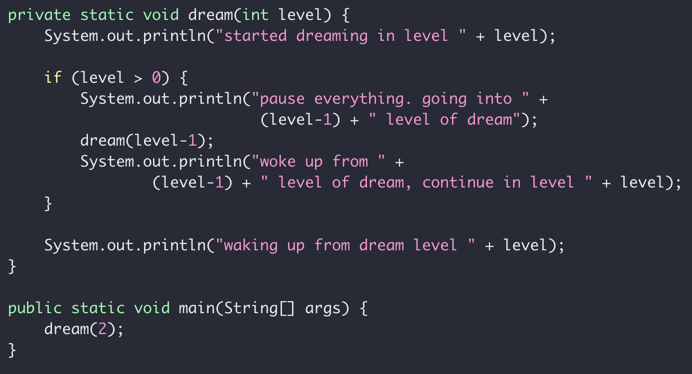
Dream in Recursion

Slide 8
Dream in Dream
Level 2
Level 0
Level 0
Time

Slide 9
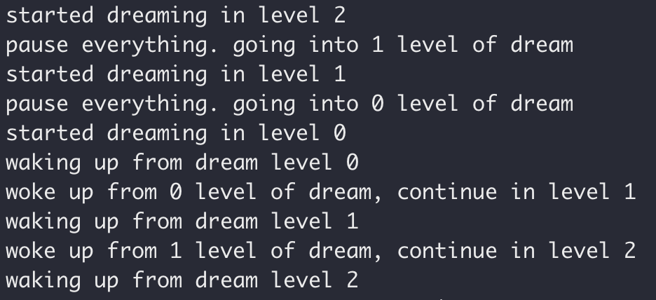
Dream in Recursion

Slide 10
Dream in Recursion

Slide 11
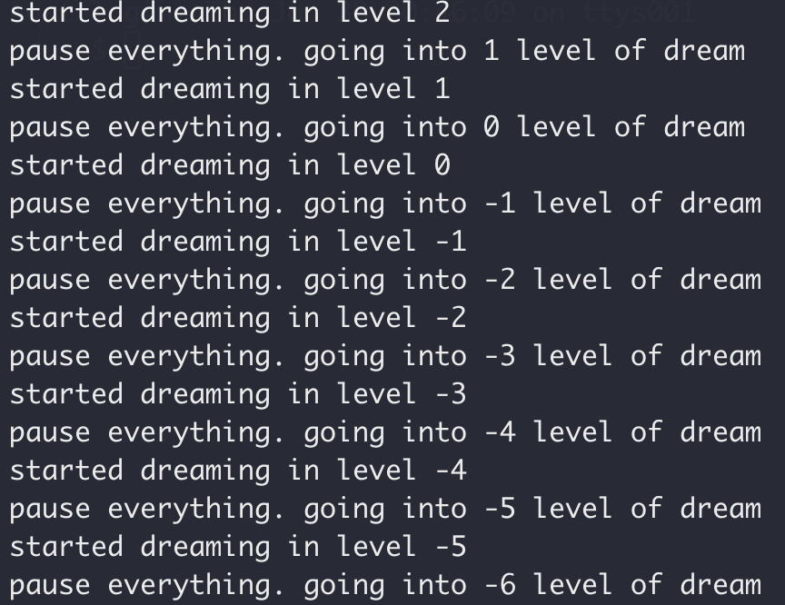
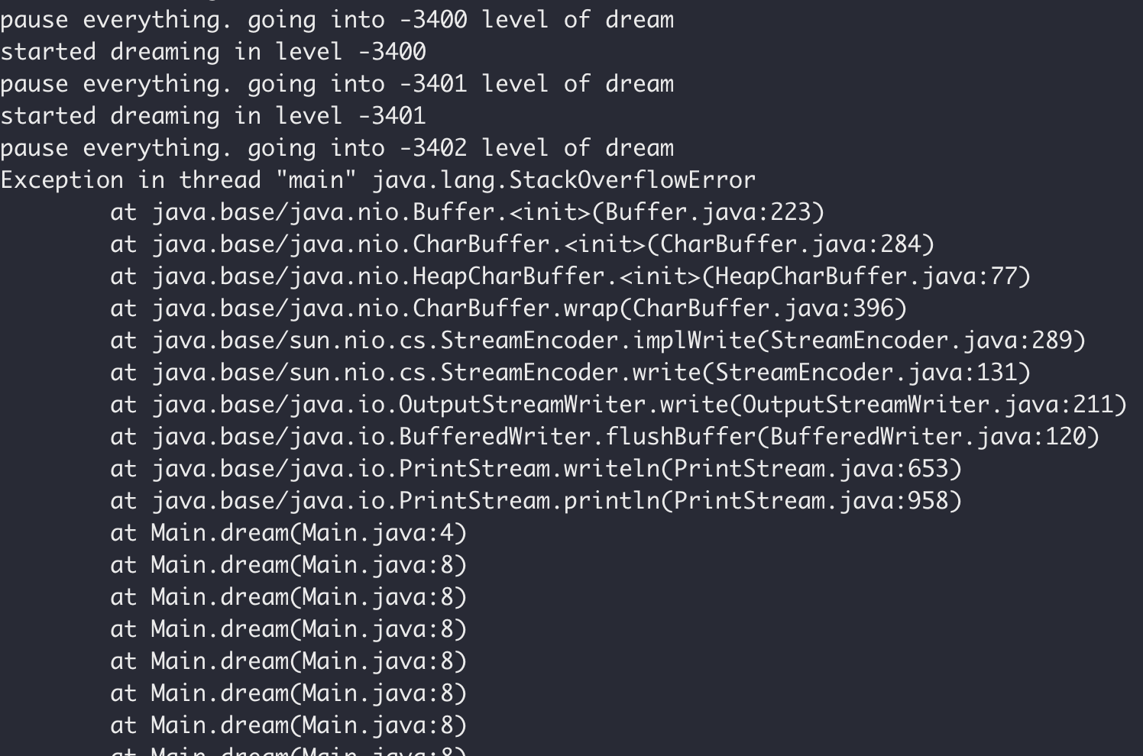
Dream in Recursion

Slide 12
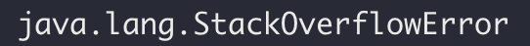
Dream in Recursion

Slide 13
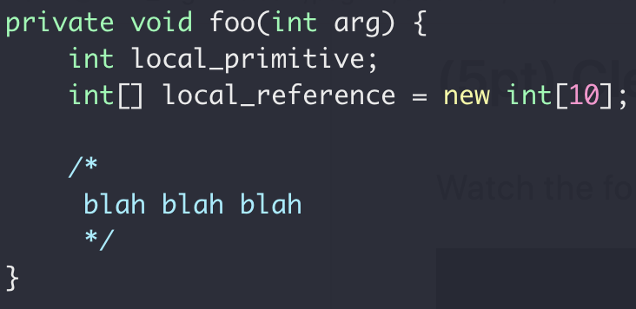
Function Call Stack
Heap
Int[10]
Stack
local_primitive
local_reference
Memory

Slide 14
Memory Map
Virtual Memory

Slide 15
Function Call Stack
Heap
Ret address
2nd round
Stack
1st round
Memory
Same code segment
Different run time state stored in memory stack

Slide 16
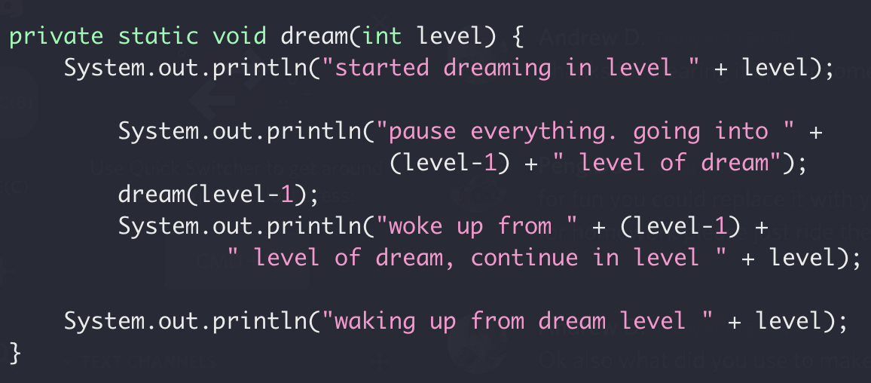
Function Call Stack
Heap
dream(2)
dream(1)
Locals for dream(0)
Return address of dream(1)
Locals for dream(1)
Stack
Return address of dream(2)
Locals for dream(2)
dream(0)
Return address of main()
Only one copy of dream(int)
Memory
More on function call
Stack buffer overflow attack
Notes:
http://www.pythontutor.com/visualize.html#mode=display

Slide 17
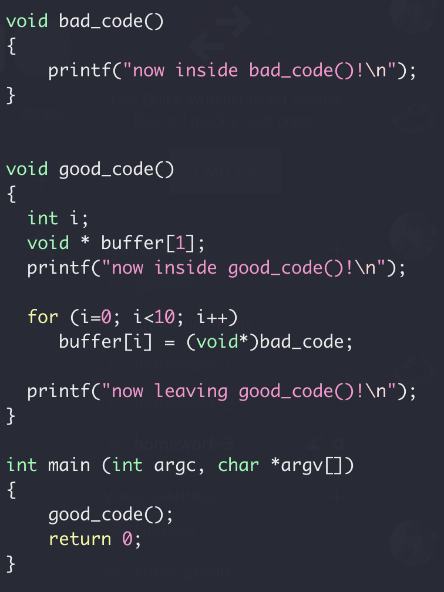
Function Call Stack
Locals for dream(1)
Stack
Return address of dream(2)
Locals for dream(2)
Return address of main()
Memory

Slide 18
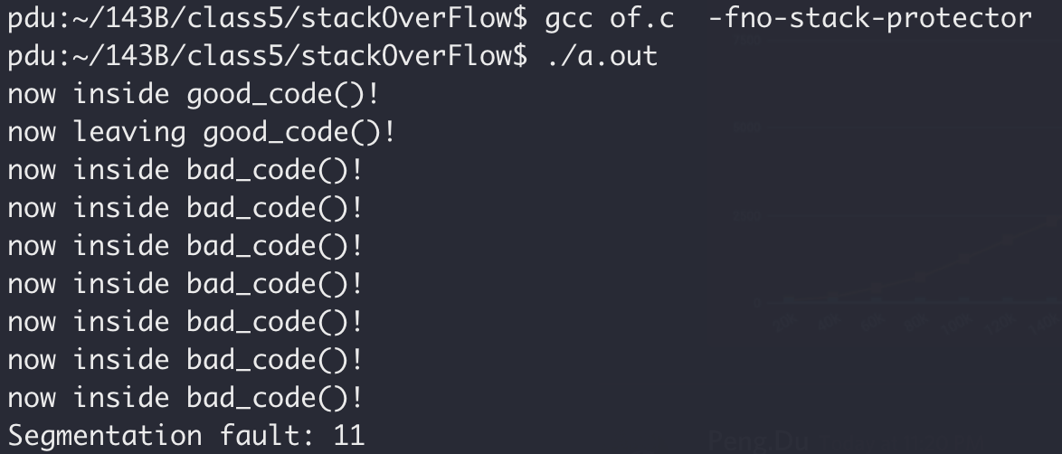
Stack Overflow Attack
Stack smashing

Slide 19
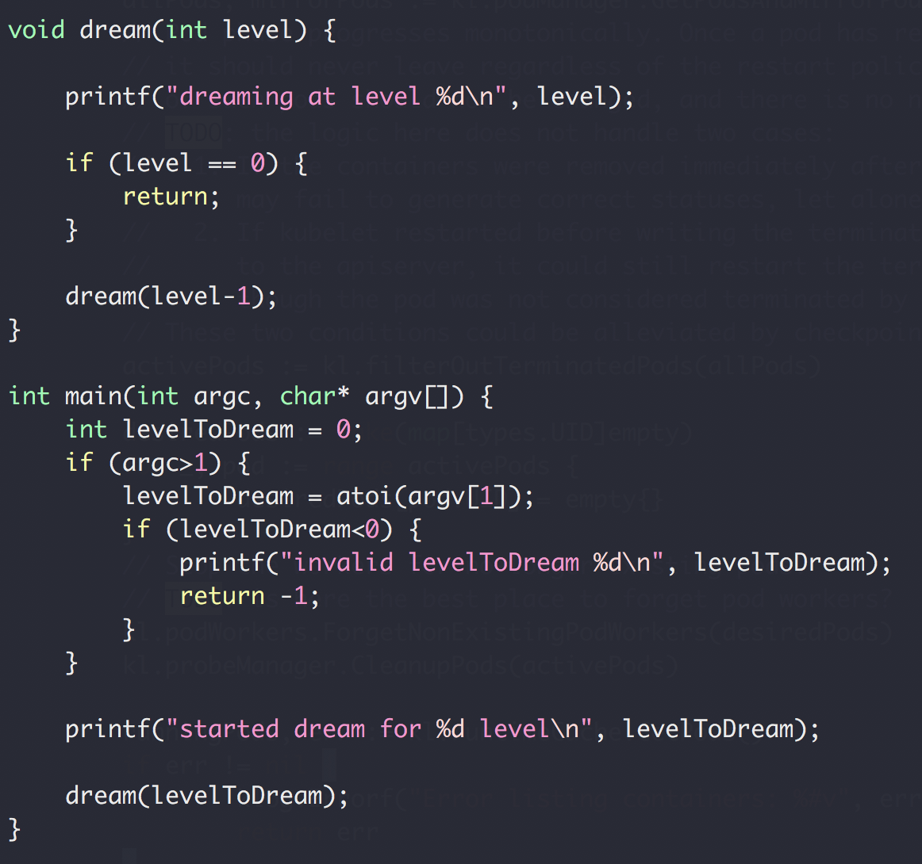
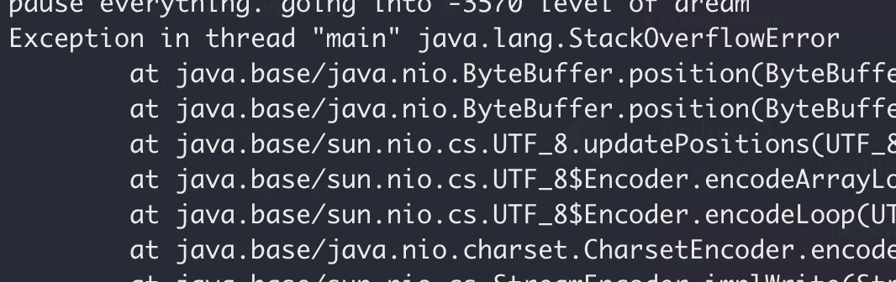
Function Call Stack
Heap
dream(N-4)
Return address of dream(N-3)
dream(N-3)
Return address of dream(N-2)
dream(N-2)
Return address of dream(N-1)
Stack
dream(N-1)
Return address of main()
main()
Memory

Slide 20
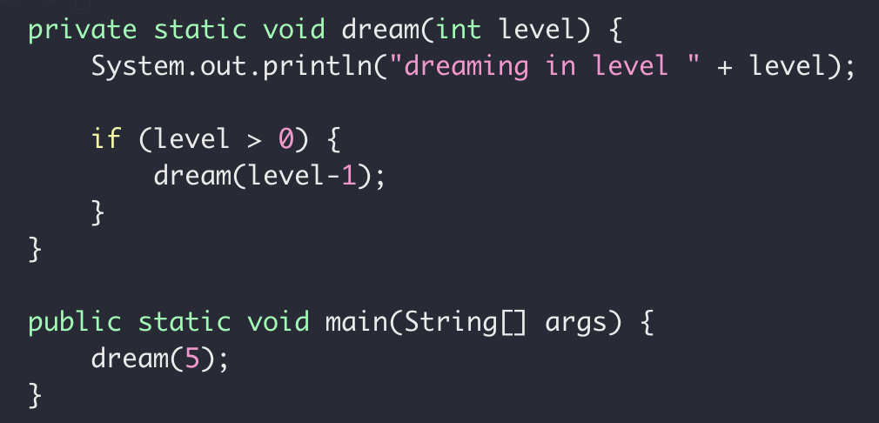
Recursion
Smaller subproblem
When the subproblem is ”small enough”
Stop recursion
solved directly

Slide 21
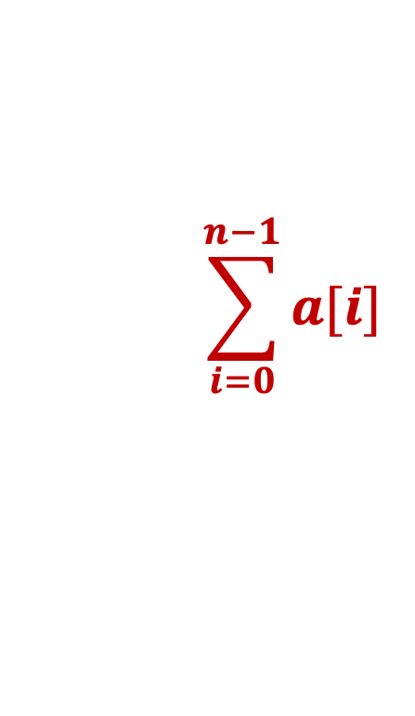
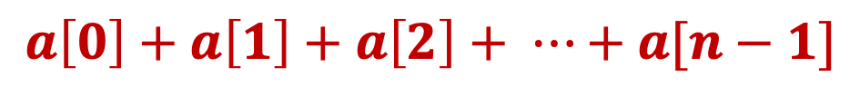
Recursive Sum
Write a function to get the sum of an integer array
$$a\left[0\right]+a\left[1\right]+a\left[2\right]+ ⋯+a[n−1]$$
$$\sum_{i=0}^{n−1}{a[i]}$$

Slide 22
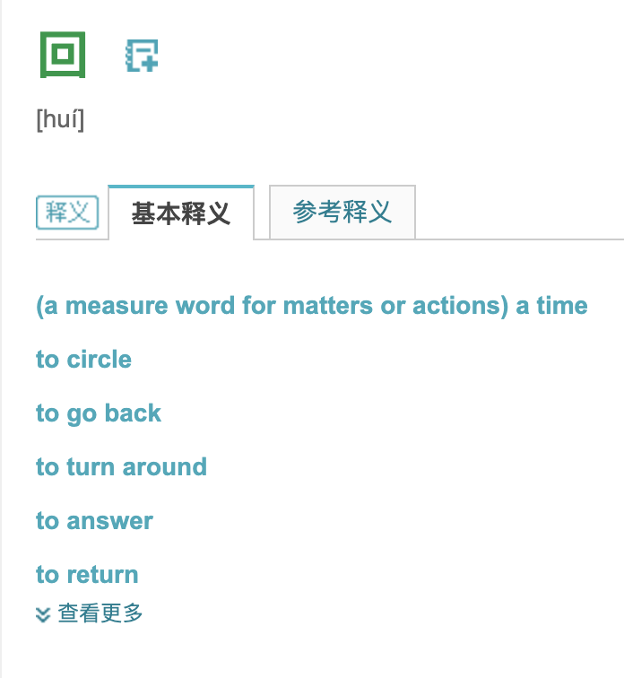
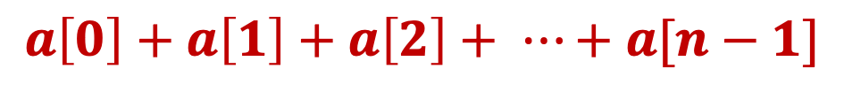
Recursive Sum
Write a function to get the sum of an integer array
$$a\left[0\right]+a\left[1\right]+a\left[2\right]+ ⋯+a[n−1]$$

Slide 23
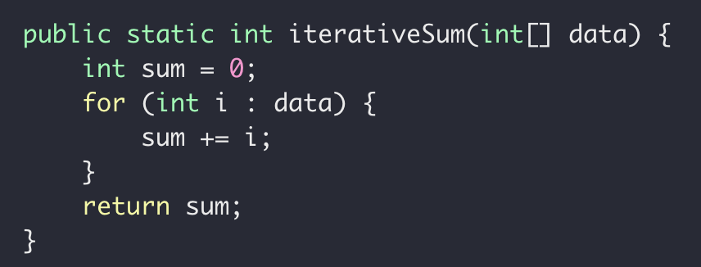
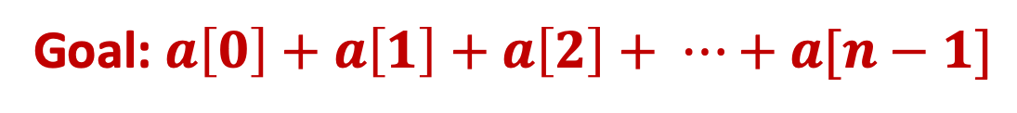
Recursive Sum
Goal: $a\left[0\right]+a\left[1\right]+a\left[2\right]+ ⋯+a[n−1]$
Iteratively

Slide 24
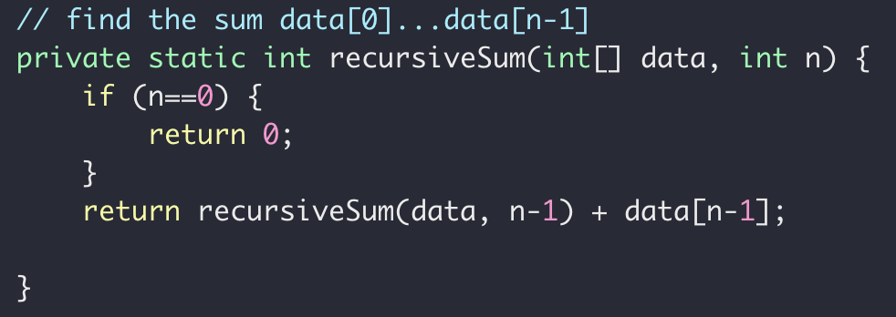
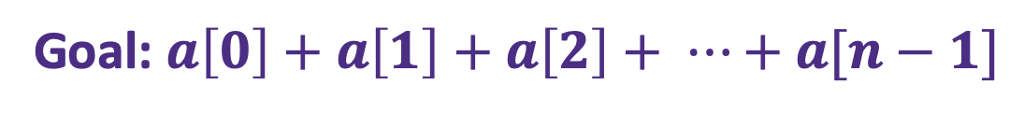


Recursive Sum
Goal: $a\left[0\right]+a\left[1\right]+a\left[2\right]+ ⋯+a[n−1]$
$sum\left(n\right)=a\left[0\right]+a\left[1\right]+ ⋯+a[n−2]+a[n−1]$
Problem
Sub-problem
$sum\left(n−1\right)=a\left[0\right]+a\left[1\right]+ ⋯+a[n−2]$
$sum\left(n−1\right)=a\left[0\right]+a\left[1\right]+ ⋯+a[n−2]$
$sum\left(n−1\right)= ?$
$sum\left(n\right)=sum(n−1)+a[n−1]$

Slide 25
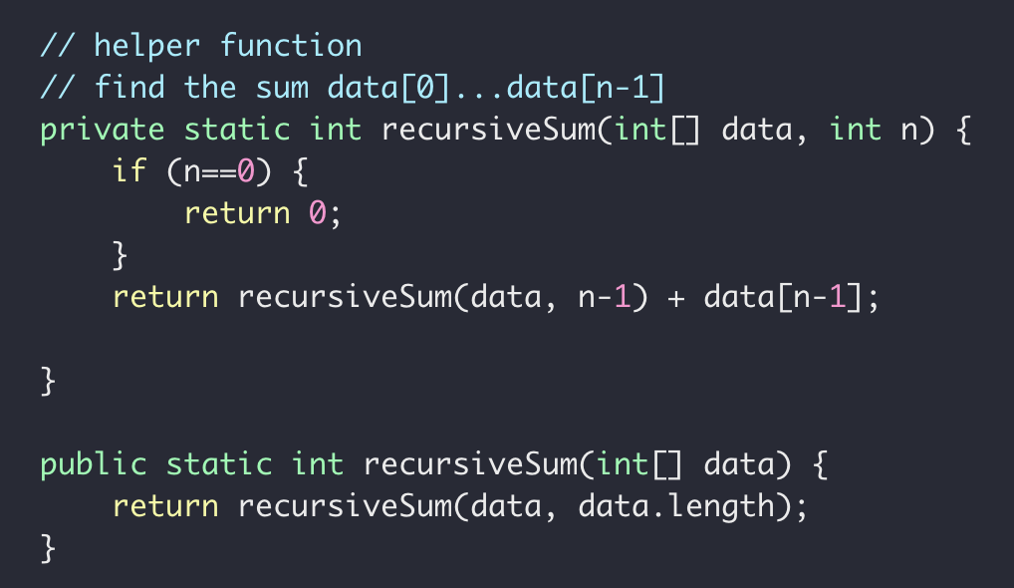
Recursive Sum
Goal: $a\left[0\right]+a\left[1\right]+a\left[2\right]+ ⋯+a[n−1]$

Slide 26




Recursive Sum
$$int \left[ \right] a=[5, 6,7,8]$$
Sum(data, 3)
Sum(data, 2)
$$=a\left[3\right]+$$
Sum(data, 1)
$$=a\left[2\right]+$$
Sum(data, 0)
$$=a\left[1\right]+$$

Slide 27
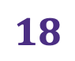

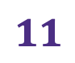




Recursive Sum
$$int \left[ \right] a=[5, 6,7,8]$$
Sum(data, 3)
$$=26$$
Sum(data, 2)
$$=8+$$
$$18$$
Sum(data, 1)
$$=7+$$
$$11$$
Sum(data, 0)
$$=6+$$
$$5$$

Slide 28
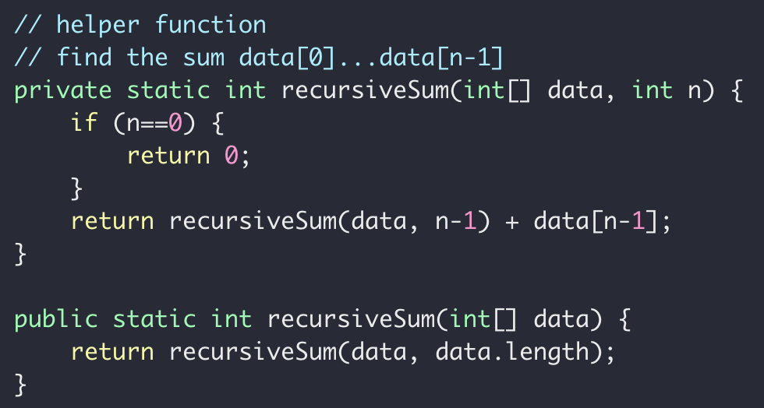
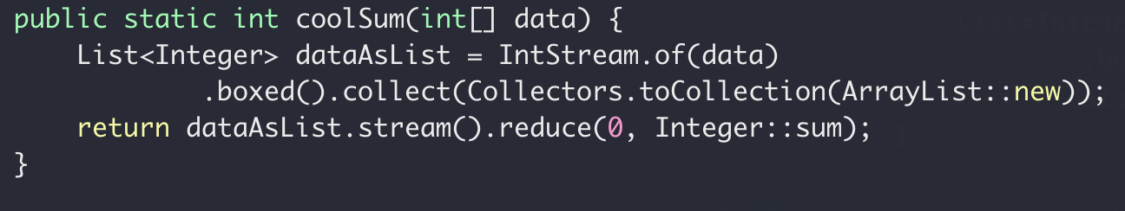
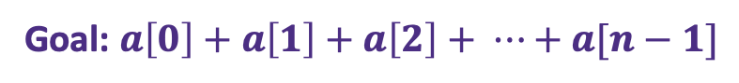
Recursive Sum
Goal: $a\left[0\right]+a\left[1\right]+a\left[2\right]+ ⋯+a[n−1]$
iterative
recursive
“modern”

Slide 29


Recursive Sum
Goal: $a\left[0\right]+a\left[1\right]+a\left[2\right]+ ⋯+a[n−1]$
Sum(data, n)
Sum(data, n-1)
$$=a\left[n−1\right]+$$
$sum\left(n\right)=a\left[n−1\right]+sum(n−1)$

Slide 30
Recursive findMax
Write a function to get the maximum of an int array
12
12
1
7
18
18
10
3
0
1
2
3
4
5
6

Slide 31
Recursion (and backtracking)
How to find the largest apple
In box 0 to 5
0
1
2
3
4
5
Largest apple:
1
1
0

Slide 32
Recursion (and backtracking)
How to find the largest apple
In box 0 to 5 (noted as [0,5])
Get the first apple from [0,5]
Find the largest apple from [1,5]
compare it with apple 0
0
1
2
3
4
5

Slide 33
Recursion (and backtracking)
How to find the largest apple
In box 1 to 5
Get the first apple from [1,5]
Find the largest apple from 2-5
compare it with apple 1
0
1
2
3
4
5

Slide 34
Recursion (and backtracking)
How to find the largest apple
In box 2 to 5
Get the first apple from [2,5]
Find the largest apple from 3-5
compare it with apple 2
0
1
2
3
4
5

Slide 35
Recursion (and backtracking)
How to find the largest apple
In box 1 to 5
Get the first apple from [3,5]
Find the largest apple from 3-5
compare it with apple 3
0
1
2
3
4
5

Slide 36
Recursion (and backtracking)
How to find the largest apple
In box 1 to 5
Get the first apple from [4,5]
Find the largest apple from 4-5
compare it with apple 4
0
1
2
3
4
5

Slide 37
Recursion (and backtracking)
How to find the largest apple
In box 1 to 5
Only 1 apple is left, it’s the largest comparing to itself
0
1
2
3
4
5

Slide 38
Recursion (and backtracking)
How to find the largest apple
In box 1 to 5
Get the first apple from [4,5]
Find the largest apple from 4-5
compare it with apple 4
0
1
2
3
4
5

Slide 39
Recursion (and backtracking)
How to find the largest apple
In box 1 to 5
Get the first apple from [4,5]
Find the largest apple from 4-5
compare it with apple 4
0
1
2
3
4
5

Slide 40
Recursion (and backtracking)
How to find the largest apple
In box 1 to 5
Get the first apple from [3,5]
Find the largest apple from 3-5
compare it with apple 3
0
1
2
3
4
5

Slide 41
Recursion (and backtracking)
How to find the largest apple
In box 1 to 5
Get the first apple from [3,5]
Find the largest apple from 3-5
compare it with apple 3
0
1
2
3
4
5

Slide 42
Recursion (and backtracking)
How to find the largest apple
In box 2 to 5
Get the first apple from [2,5]
Find the largest apple from 3-5
compare it with apple 2
0
1
2
3
4
5

Slide 43
Recursion (and backtracking)
How to find the largest apple
In box 1 to 5
Get the first apple from [1,5]
Find the largest apple from 2-5
compare it with apple 1
0
1
2
3
4
5

Slide 44
Recursion (and backtracking)
How to find the largest apple
In box 1 to 5
Get the first apple from [1,5]
Find the largest apple from 2-5
compare it with apple 1
0
1
2
3
4
5

Slide 45
Recursion (and backtracking)
How to find the largest apple
In box 1 to 5
Get the first apple from [1,5]
Find the largest apple from 2-5
compare it with apple 1
0
1
2
3
4
5

Slide 46
Recursion (and backtracking)
How to find the largest apple
In box 0 to 5 (noted as [0,5])
Get the first apple from [0,5]
Find the largest apple from [1,5]
compare it with apple 0
0
1
2
3
4
5

Slide 47
Recursion (and backtracking)
How to find the largest apple
In box 0 to 5 (noted as [0,5])
Get the first apple from [0,5]
Find the largest apple from [1,5]
compare it with apple 0
0
1
2
3
4
5

Slide 48
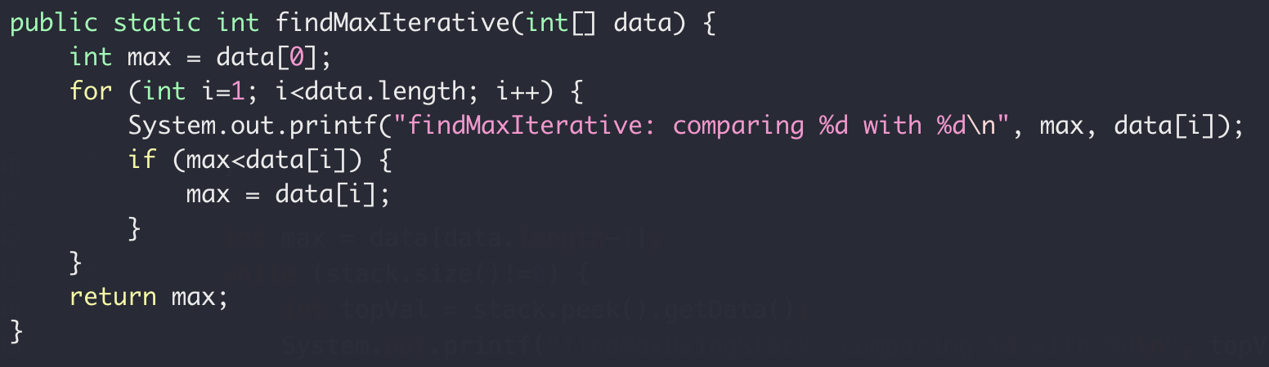
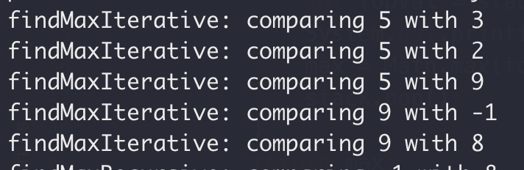
Recursive Max
Iteratively
5
3
2
9
-1
8
0
1
2
3
4
5

Slide 49
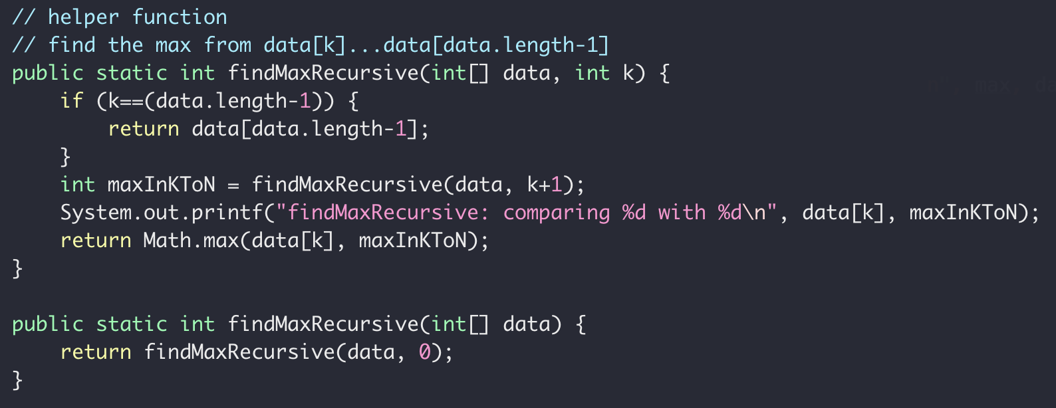
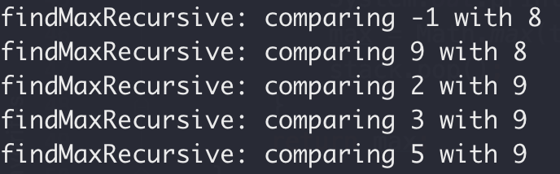
Recursive Max
5
3
2
9
-1
8
0
1
2
3
4
5
Recursively

Slide 50
Recursive Linked List Print
Print linked list values backward
inplace
head
8
3
2
9
5
6
null
6, 5, 9, 2, 3, 8

Slide 51
Recursive Linked List Print
8
3->…->6
head
3
2
9
5
6
r(8->…->6) = r(3->…->6) + “8”
null
3
2->…->6
2
9
5
6
null
r(3->2->…->6) = r(2->…->6) + “3”

Slide 52
Recursive Linked List Print
2
9->…->6
9
5
6
null
r(2->…->6) = r(9->…->6) + “2”
9
5->6
5
6
null
r(9->…->6) = r(5->6) + “9”
5
6
6
null
r(5->6) = r(5)+“6”

Slide 53
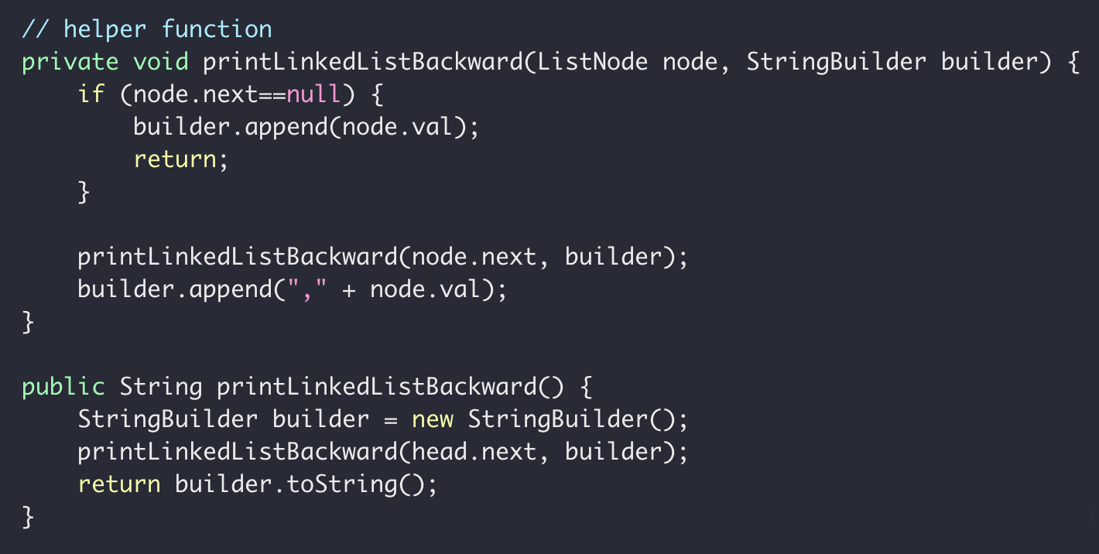
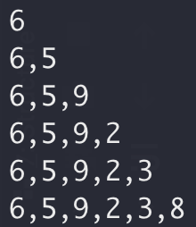
Recursive Linked List Print
builder
But can you do this without recursion?
OK to use additional space

Slide 54
Recursive Linked List Print
head
8
3
2
9
5
6
null
Visit
Print
Visit 8 first
FILO
STACK!!
Print 8 fast
builder

Slide 55
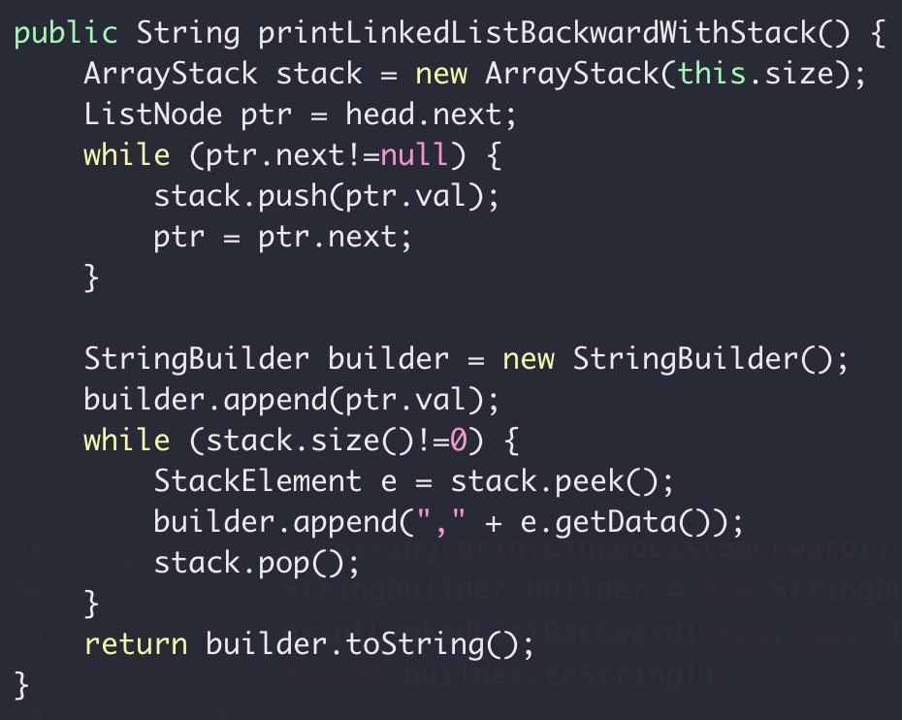
Wednesday
builder

Slide 56
Recursive Linked List Print
head
8
3
2
9
5
6
null
Return address
node.val
Stack
Return address
node.val
Return address

Slide 57
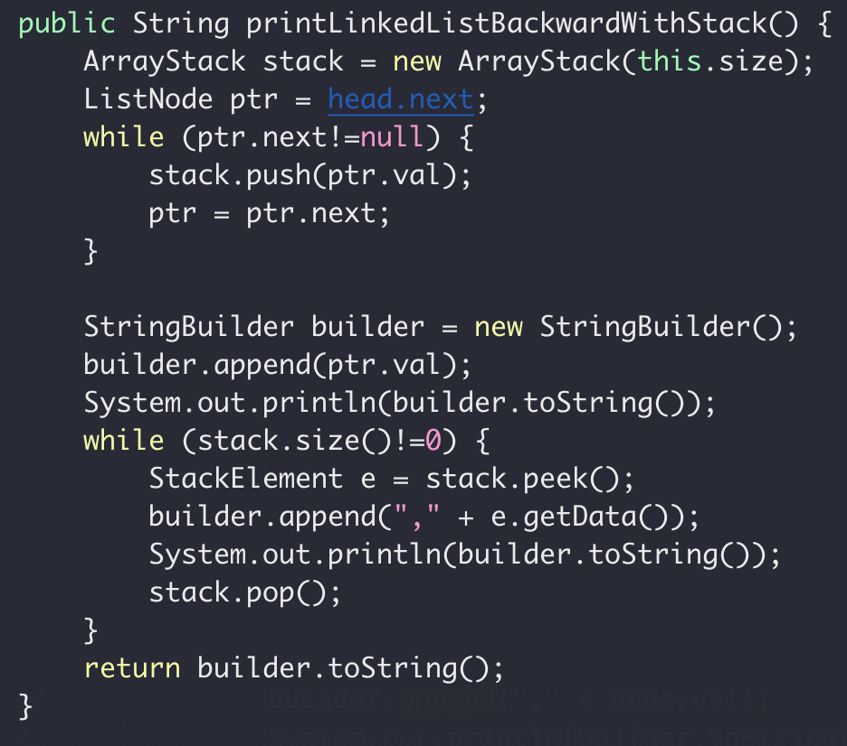
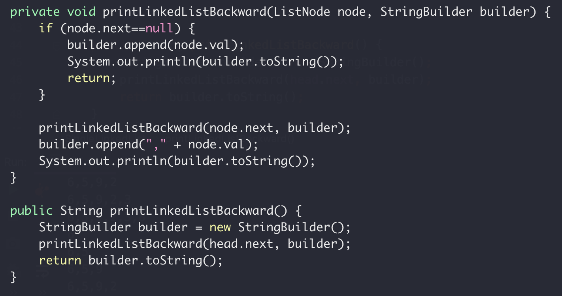
Recursive Summary
Recursion
Iterative + Stack

Slide 58

Recursive Summary
Smell of Recursion
Solution ← Solution of a subproblem
$sum\left(n\right)=a\left[n−1\right]+sum(n−1)$
Depth First Visit
head
8
3
2
9
5
6
null
Visit

Slide 59
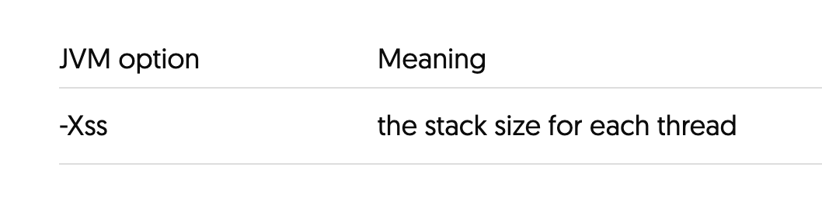
Recursive Summary: Cons
Stack size of memory is usually limited (smaller than heap)
More on JVM memory tuning
Function call overhead
Stack Overflow Risk

Slide 60

Recursion
“you never really remember
the beginning of a dream, do you?”
$−$ Inception

Slide 61
Wednesday

Slide 62
Recursion
Binary Search
Linear Search (target 12)
5 3 1 9 8 7 12 2 4
5 3 1 8 7 9 2 4 12
O(N) Can we do better?
Worse case we have to iterate N element

Slide 63
Binary Search
“Who checked that bug in?!!”
Source control svn, git, etc
1
2
3
4
5
6
7
8
9
10
Mike
Peng
Ethan

Slide 64

Binary Search
“Who checked that bug in?!!”
Source control svn, git, etc
Found a bug in version 10
No bug in version 1
?
?
?
?
?
?
?
?
1
2
3
4
5
6
7
8
9
10

Slide 65
Binary Search
Source control svn, git, etc
“Who checked that bug in?!!”
Found a bug in version 10
No bug in version 1
?
?
?
?
?
?
?
?
1
2
3
4
5
6
7
8
9
10

Slide 66
Binary Search
Source control svn, git, etc
“Who checked that bug in?!!”
Found a bug in version 10
No bug in version 1
?
?
?
?
?
?
?
?
1
2
3
4
5
6
7
8
9
10

Slide 67
Binary Search
Source control svn, git, etc
“Who checked that bug in?!!”
Found a bug in version 10
No bug in version 1
?
?
?
?
?
1
2
3
4
5
6
7
8
9
10
Bug introduced, found with 3 checks

Slide 68
Binary Search
Binary Search (target 12)
1 2 3 4 5 7 8 9 12
1 2 3 4 5 7 8 9 12
1 2 3 4 5 7 8 9 12
1 2 3 4 5 7 8 9 12
1 2 3 4 5 7 8 9 12
O(logN) both average and worst case

Slide 69
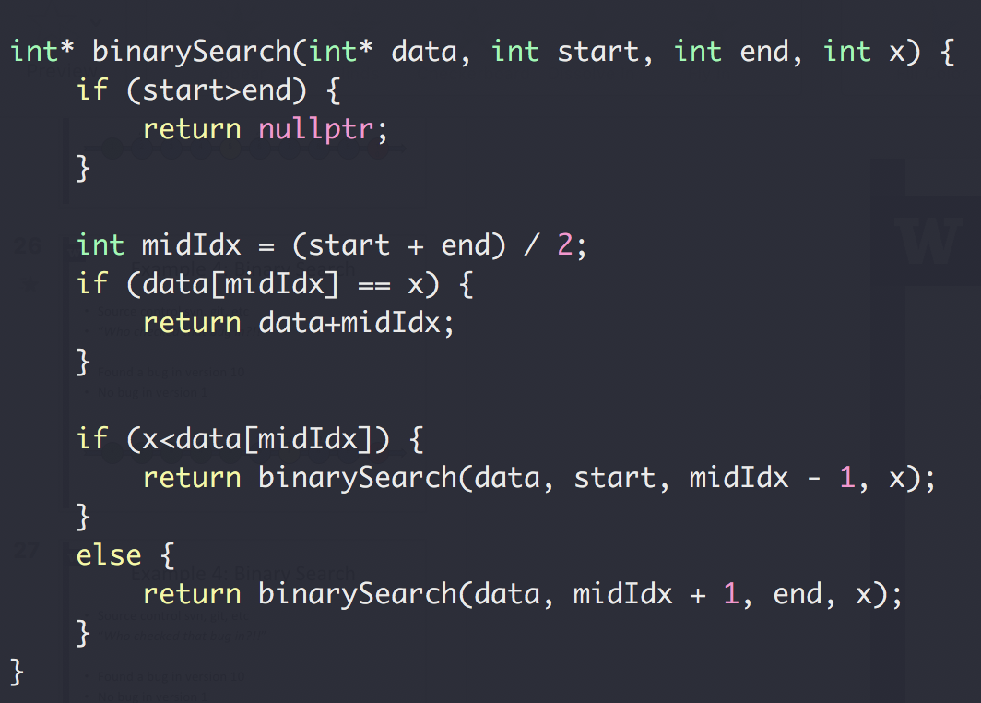
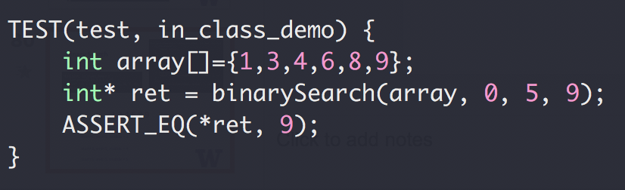
Binary Search

Slide 70
Binary Search
1,3,4,6,8,9
start=0, end=5, midIdx = 2
start=3, end=5, midIdx = 4
start=5, end=5, midIdx = 5

Slide 71
Binary Search
Up to 2³¹-1 for 32-bit signed int
What could go wrong?
The Java programming language library had this bug for 20+ years

Slide 72
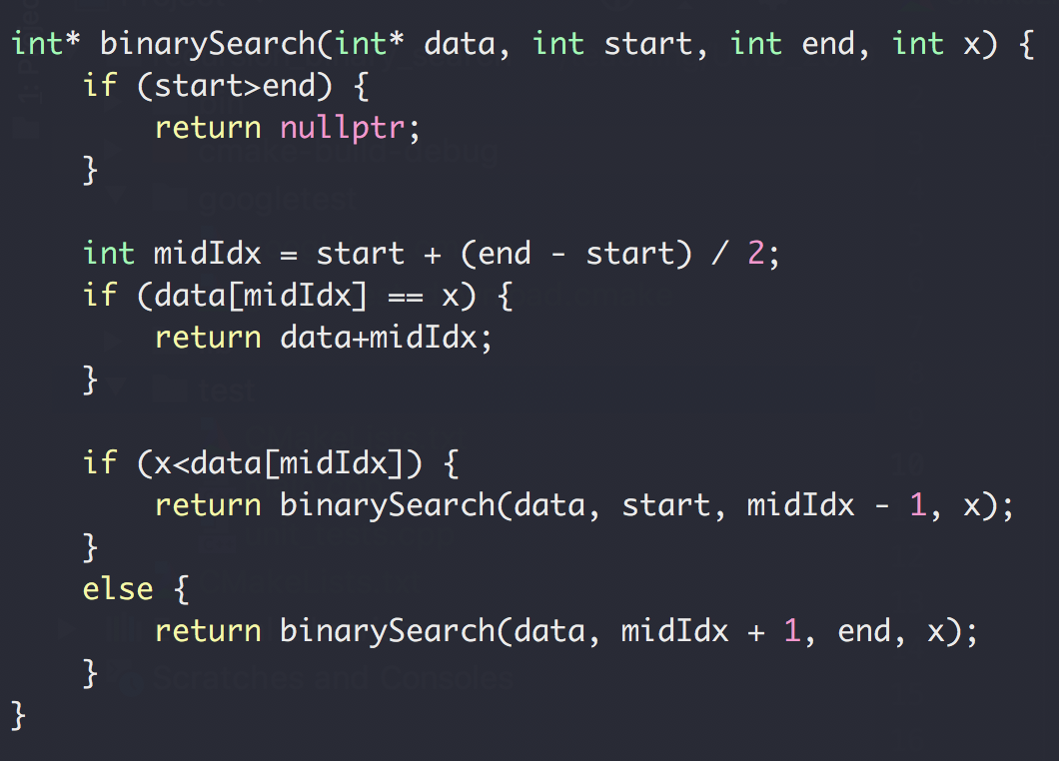
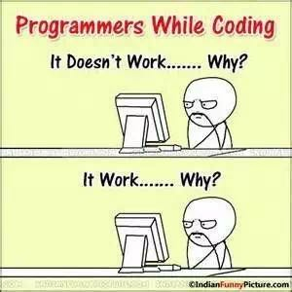
Binary Search

Slide 73
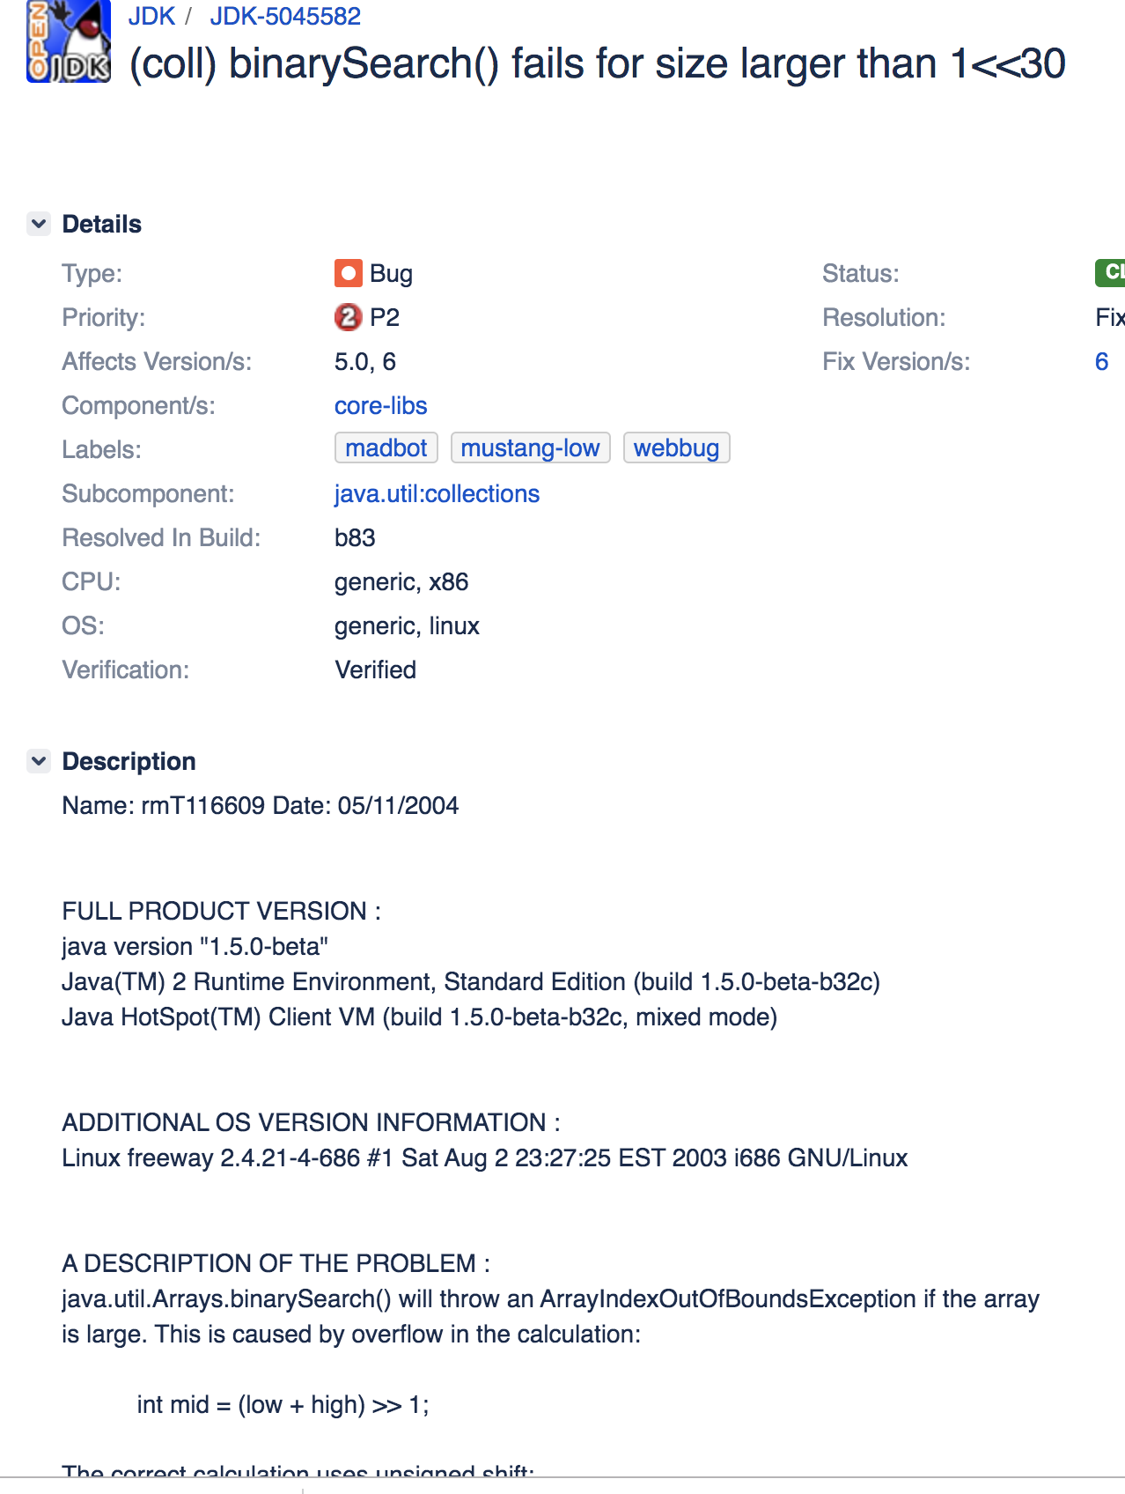
Binary Search
https://bugs.openjdk.java.net/browse/JDK-5045582

